Slide 1
By F. Ghavipanjeh fghavipanjeh@gmail.com

Slide 2
jump

Slide 3
fly

Slide 4
run

Slide 5
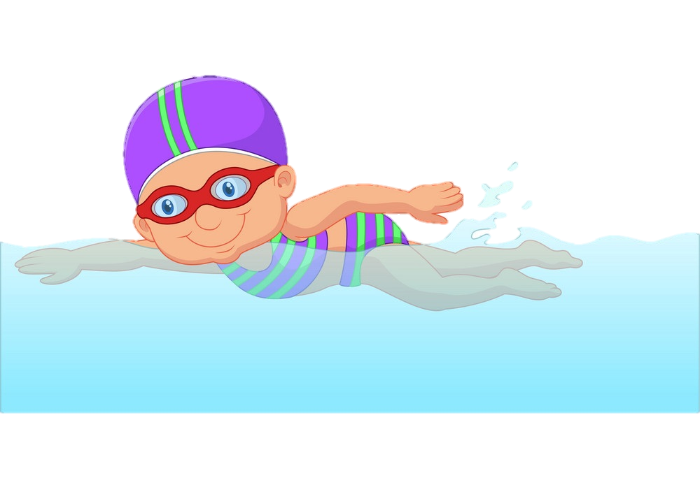
swim

